Slide 1
Sampling and Estimation

Slide 2
Session 4: Sampling, Estimation

Slide 3
Learning objectives of this unit
At the end of the session on unit 3, the student should be able to
Define population, sample. Why sampling techniques needed?
Distinguish between different sampling methods
Understand sampling variation, point estimates, interval estimates, and confidence interval.
Compute 100 (1-α)% CI for mean, proportion, variance and ratio of variances
Define central limit theorem

Slide 4
Population may be unknown or infinite
Even if population is countably finite, resources (Money, Manpower, Material and Time (3MT) required may be huge
Sampling: A process by which representative samples are selected from a well defined population
Why sampling?

Slide 5
Samples selected as representative of population gives consistent and reliable results (Estimates), what could have been obtained from Population (True value)
Why sampling?

Slide 6
Non-probability sampling
Simple random sampling
Purposive sampling
Systematic random sampling
Convenient sampling
Stratified random sampling
Quota sampling
Multistage random sampling
Snowball technique
Probability sampling
Sampling techniques

Slide 7
Sampling variation

Slide 8
Population of Wages of employees of an organization
1861 | 2495 | 1000 | 2497 | 1865 | 791 | 2090 | 2637 | 1327 | 1678
1680 | 2858 | 795 | 2495 | 2496 | 2501 | 1160 | 1480 | 1860 | 2490
2090 | 2840 | 2490 | 2640 | 659 | 827 | 2646 | 2638 | 2643 | 868
1327 | 1866 | 1861 | 2486 | 2865 | 3011 | 2494 | 1489 | 1865 | 2855
2840 | 2499 | 2093 | 2660 | 1165 | 2600 | 2085 | 2640 | 2998 | 1861
2956 | 2495 | 2865 | 1865 | 3000 | 3019 | 1670 | 2858 | 2642 | 1680
3038 | 3000 | 1313 | 596 | 656 | 3240 | 590 | 2501 | 2485 | 3015
2092 | 1679 | 3024 | 2497 | 2825 | 2630 | 2070 | 2900 | 1861 | 2636
2495 | 2637 | 2497 | 1159 | 2640 | 3050 | 870 | 2896 | 2500 | 2638
926 | 2860 | 1481 | 875 | 2482 | 1860 | 2086 | 934 | 3200 | 2490

Slide 9
Select different samples of varied sizes
Sample 1
3000 | 2486 | 820 | 1678 | 2070 | 2638 | 2490 | 1865 | 1000 | 2090 | 596 | 3200
Sample 2
2840 | 2858 | 3000 | 2490 | 2998 | 3050 | 2070 | 2896 | 3200 | 2490 | 3280
Sample 3
2858 | 3240 | 2497 | 2865 | 656 | 2093 | 934 | 1861 | 868 | 795
Sample 4
2086 | 1000 | 2497 | 596 | 656 | 875 | 2085 | 934 | 1313
Sample 5
820 | 1313 | 3000 | 2640 | 596 | 2640 | 2600 | 2495 | 934 | 2500

Slide 10
Select different samples of varied sizes
Sample 6
2840 | 2499 | 1327 | 1861 | 2495 | 3024 | 3038 | 2497
Sample 7
2858 | 2490 | 868 | 1670 | 1480 | 2643 | 1480 | 1680 | 2085 | 2490
Sample 8
2495 | 2858 | 1861 | 2092 | 2499 | 3000 | 2660 | 1000 | 1679 | 926 | 2660
Sample 9
795 | 791 | 3200 | 2085 | 2638 | 2497 | 2486 | 1159 | 2640
Sample 10
3019 | 3240 | 3200 | 3050 | 3000 | 3015 | 2900 | 2896 | 2998

Slide 11
Compute sample mean of these samples
True (not observable) value
Mean wage = Rs.2162.24

Slide 12
Sample No. | Sample size | Mean | SD
1 | 12 | 1994.42 | 843.23
2 | 11 | 2830.18 | 349.94
3 | 10 | 1866.70 | 988.57
4 | 9 | 1338.00 | 704.36
5 | 10 | 1953.80 | 920.44
6 | 8 | 2447.63 | 590.64
7 | 10 | 1974.40 | 638.05
8 | 11 | 2157.27 | 715.10
9 | 9 | 2032.33 | 891.53
10 | 9 | 3035.33 | 117.40
Overall | 100 | 2162.24 | 732.26

Slide 13
Sampling variation
Variation in Sample estimates, even if the samples drawn are from same population

Slide 15
The most important one to be computed from these sample estimates is the standard deviation of sample mean, sample proportion, Sample correlation etc. as we are computing for individual observations

Slide 16
Sampling distribution

Slide 17
Definition
The probability distribution of a statistic (sample estimate) is called sampling distribution.
The sampling distribution of a statistic depends on the distribution of the population, the size of the sample, and the method of sample selection.

Slide 18
Sampling distribution of means
Suppose that a random sample of size n taken from a normal population with mean µ and variance σ². Now each observation in a sample X₁, X₂, …, X_{n} is a normally and independently distributed random variable with mean µ and variance σ² . Then by the reproductive property of normal distribution

Slide 19
Sampling distribution of means
The sample mean
has a normal distribution with mean
and variance

Slide 20
Sampling distribution of means
If we are sampling from a population that has an unknown probability distribution, the sampling distribution of the sample mean will still be approximately normal with mean µ and variance σ²/n if the sample size n is large. This is one of the most useful theorems in statistics called central limit theorem

Slide 21
Sampling distribution of proportions
Suppose that a random sample of size n taken from a binomial population with mean µ=np and variance σ²=npq. By defining Z=(Estimator-mean)/SD, and with mean µ=np > 5 and as increases, the binomial distribution converges to standard normal distribution. Hence, the sampling distribution of sample proportion is distributed as standard normal distribution.

Slide 22
Sampling distribution of variance
Like the sampling distribution of proportion and mean, the sampling distribution of sample variance can also be found. Since the variance S² cannot be negative, the sampling distribution of S² is not normal. In fact it is related to Gamma distribution.
Define is a random variable having Chi-square distribution with ν = n-1 degrees of freedom.

Slide 23
Sampling distribution of ratio of variances
Suppose that we have two independent normal population with unknown variance σ₁² and σ₂² respectively. We have two random sample of sizes n₁ and n₂ respectively, from these two populations and let S₁² and S₂² be the two sample variances. Then we can find 100(1-α)% CI for the ratio of the two variances

Slide 24
Sampling distribution of ratio of variances
The sampling distribution of the ratio of the two variances is distributed as Fisher’s F-distribution with (n₂-1, n₁-1) degrees of freedom (df), that is,
is distributed with (n₂-1, n₁-1) df.

Slide 25
Central Limit Theorem
If X₁, X₂, …, X_{n} is a random sample of size n taken from a population (either finite or infinite) with mean µ and variance σ², and if X is the sample mean, then the limiting form of the distribution of
as n→∞, is the standard normal
distribution with mean 0 and variance 1

Slide 26
Standard error or mean
Standard error of mean is
where s is the standard deviation of observations in the observed sample and n is the number of observations in the sample.

Slide 27
Standard error of proportion
Standard error of a proportion is
where p is the proportion of occurrence of an event in the observed sample, q = (1 – p) and
n is the number of observations in the sample

Slide 28
Standard error of difference between two means if the two sample sizes are not equal
where
- s₁: the sample SD of group 1
- s₂: the sample SD of group 2
- n₁: the sample size of group 1
- n₂: the sample size of group 2

Slide 29
Standard error of difference between two means if the two variances are not equal
where
- s₁: the sample SD of group 1
- s₂: the sample SD of group 2
- n₁: the sample size of group 1
- n₂: the sample size of group 2

Slide 30
Standard error of difference between two means if the two samples are not equal
where

Slide 31
Standard error of difference between two proportions when two sample sizes are same
where
- p₁ : The sample proportion of occurrence of an event in the group 1
- p₂ : The sample proportion of occurrence of an event in the group 2
- n₁: The sample size of group 1
- n₂: The sample size of group 2

Slide 32
Standard error of difference between two proportions
where

Slide 33
where
- p₁ : The sample proportion of occurrence of an event in the group 1
- p₂ : The sample proportion of occurrence of an event in the group 2
- n₁: The sample size of group 1
- n₂: The sample size of group 2

Slide 34
Point estimation
Point estimate is a single number, calculated from available sample data that is used to estimate the value of an unknown parameter

Slide 35
Point estimation
The statistic
♣ Mean (x)
♣ Variance (s²)
♣ Proportion (p)
♣ Correlation (r) etc.,
computed from sample observations
estimates of population parameters μ, σ², P,
and ρ

Slide 36
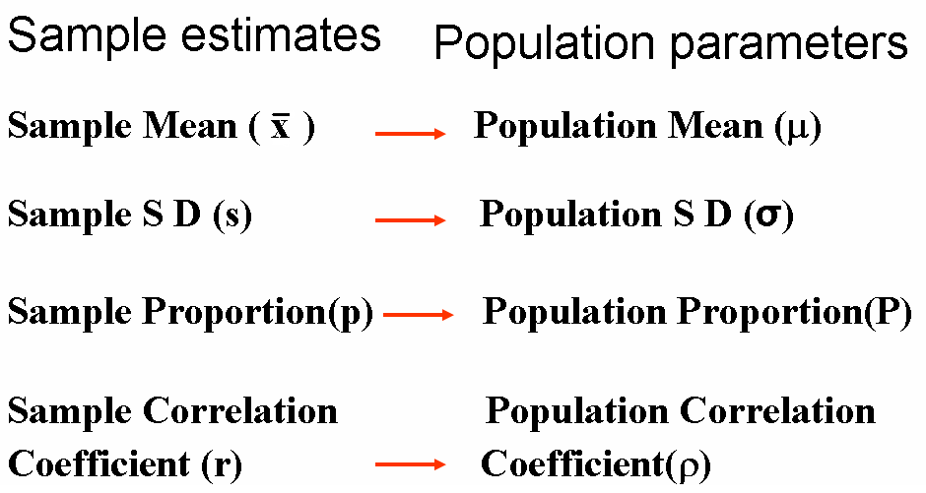

Slide 37
Interval estimation
Interval estimate is an interval that provides a lower and upper bound for a specific unknown parameter.
Undoubtedly, the most powerful type of inference.

Slide 38
Confidence Interval
Computation of 100 (1-α)% confidence interval is the most common way of finding the interval estimate, where α is the probability of type I error.

Slide 39
Confidence Interval
Confidence interval is an interval of numbers believed to contain the parameter value.
The probability, the method produces an interval that contains the parameter is called the confidence level. Most studies use a confidence level close to 1, such as 0.95 or 0.99.

Slide 40
Most CIs have the form
Point estimate ± Margin of error
with margin of error based on spread of
sampling distribution of the point estimator;
e.g., margin of error  2 (standard error) for
95% confidence.

Slide 41
Finding Confidence Interval in practice
The100 (1-α)% confidence interval for mean is
For α=0.05,
For α=0.01,

Slide 42
Example
Suppose a regional computer center wants to find the performance of its disk memory system. One measure is the average time between failure of its disk drive. The mean time between failure of a random sample of 20 disk drive is 1762 hours with a population standard deviation of 215. Construct (i) 95% CI and (ii) 99% CI for mean time between failure of its disk drive.
The SE (mean)=
95% CI= 1762 ± 1.96 (48.1) = (1762 - 94.28, 1762 + 94.28)
= (1667.72, 1856.28)
99% CI= 1762 ± 2.58 (48.1) = (1762 – 124.10, 1762 + 124.10)
= (1637.90, 1886.10)

Slide 43
Finding Confidence Interval for proportion
The100 (1-α)% confidence interval for proportion is
For α=0.05,
For α=0.01,

Slide 44
Example
It was observed that 4 out of every 20 persons own an Audi car in a city. Construct (i) 95% CI and (ii) 99% CI for the proportion of persons owning an Audi car.
The SE (proportion)=
95% CI= 0.2 ± 1.96 (0.09) = (0.2 – 0.18, 0.2 + 0.18)
= (0.02, 0.38)
99% CI= 0.2 ± 2.58 (0.09) = (0.2 – 0.23, 0.2 + 0.23)
= (-0.03, 0.43)

Slide 45
Finding Confidence Interval for difference between two means
The100 (1-α)% confidence interval for difference between two means

Slide 46
A taxi company is trying to decide whether to purchase brand A or brand B tires for its fleet of taxis. To estimate difference in two brands, an experiment is conducted using 30 of each brand. The tires are run until they wear out. Construct
(i) 95% CI and (ii) 99% CI for mean difference in mileage between two brands.
Brands | Sample size | Mean (kms) | SD (kms)
A | 30 | 36300 | 5000
B | 40 | 38100 | 6100

Slide 47
The SE (Diff. in mean) =
where
Solution:

Slide 48
(i) 95% CI for difference between means is
= (36300 -38100) ± 1.96 x 1496.42
= - 1800 ± 2932.98
= (- 4732.61, 1132.98)
(i) 99% CI for difference between means is
= (36300 -38100) ± 2.58 x 1496.42
= - 1800 ± 3524.61
= (-5660.76, 2060.76)
Actual difference between means is 1800 kms
Twice the SE (diff. in mean)= 2x 1496.42 = 2992.84
Inference: There is no difference in the mileage between the two
brands of tires. Hence, either of the brand can be chosen

Slide 49
Inference:
- If the actual difference between means <
Twice the SE (diff. in mean), then no difference
between the two group means.
- If the actual difference between means ≥
Twice the SE (diff. in mean), then there is
difference between the two group means.

Slide 50
Finding Confidence Interval for proportion
The100 (1-α)% confidence interval for proportion is
The100 (1-α)% confidence interval for difference between proportions

Slide 51
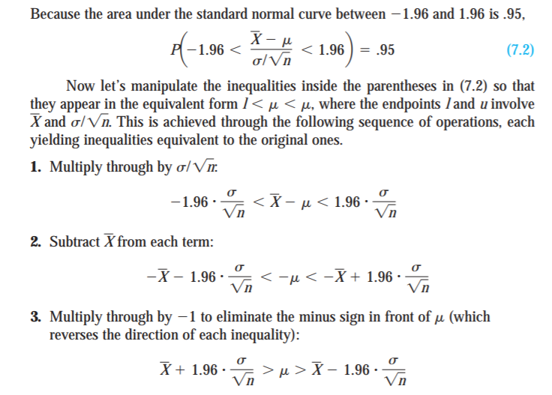
Confidence interval - derivation

Slide 52
The following data relates to the two judges who have declared innocent defendants as guilty (false positives) due to lack of evidence. Construct 95% and 99% CI for difference in proportions
Judges | No. of defendants (n) | No. of false positives | False positive rate
1 | 2500 | 22 | 0.88%
2 | 3000 | 90 | 3.00%

Slide 53
The SE (Diff. in Proportion) =
where

Slide 54
The pooled proportion =
The SE (Diff. in Proportion) =

Slide 55
(i) 95% CI: (p₁-p₂) ± z_{0.025} SE (p₁-p₂)
= (0.88-3.00) ± 1.96 x 0.003
= - 2.12 ± 0.006
= (-2.126, -2.114)
(ii) 99% CI: (p₁-p₂) ± z_{0.005} SE (p₁-p₂)
= (0.88-3.00) ± 2.58 x 0.003
= - 2.12 ± 0.008
= (-2.128, -2.112)

Slide 56
Actual difference between proportion
= 3.00-0.88
= 2.12
Twice the SE (diff. in proportion) = 0.006
Inference: Observed difference (2.12 > 2 SE(p₁-p₂)). Hence, the two judges have differ in with respect to false positive rate.

Slide 57
Large samples have narrower widths than small samples
Higher confidence levels have wider intervals than lower confidence levels
Narrow widths and high confidence levels are desirable, but these two things affect each other

Slide 58
Sampling distribution of variance
The 100(1-α)%CI for variance of normal distribution σ² is given by

Slide 59
Sampling distribution of ratio of variances
Then we can find 100(1-α)% CI for the ratio of the two variances is given by
ie.,

Slide 60
